Slide 1
TensorBoard
: Logistic regression, MLP, and CNN

Slide 2
How it works:
1. Use “with tf.variable_scope(“NAME”):
2. Define summary writer
- summary_writer = tf.train.SummaryWriter(“PATH”, graph=sess.graph)
3. Define scalars to summary
- tf.scalar_summary(‘cross_entropy’, cost)
- tf.scalar_summary(‘accuracy’, accr)
4. Merge summaries
- merged = tf.merge_all_summaries()
5. Session run merge
- summary = sess.run(merged, feed_dict: ~)
6. Add to summary writer
- summary_writer.add_summary(summary, index)

Slide 3
TensorBoard
Logistic regression

Slide 4
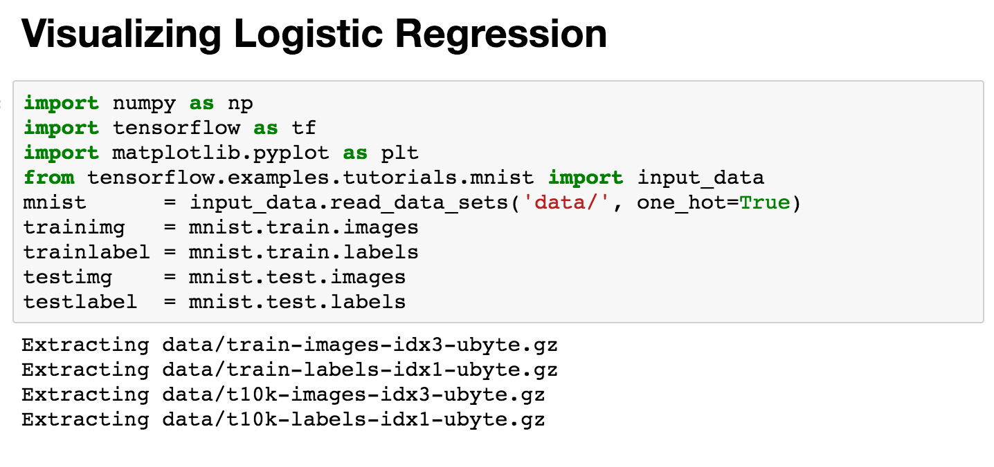

Slide 5
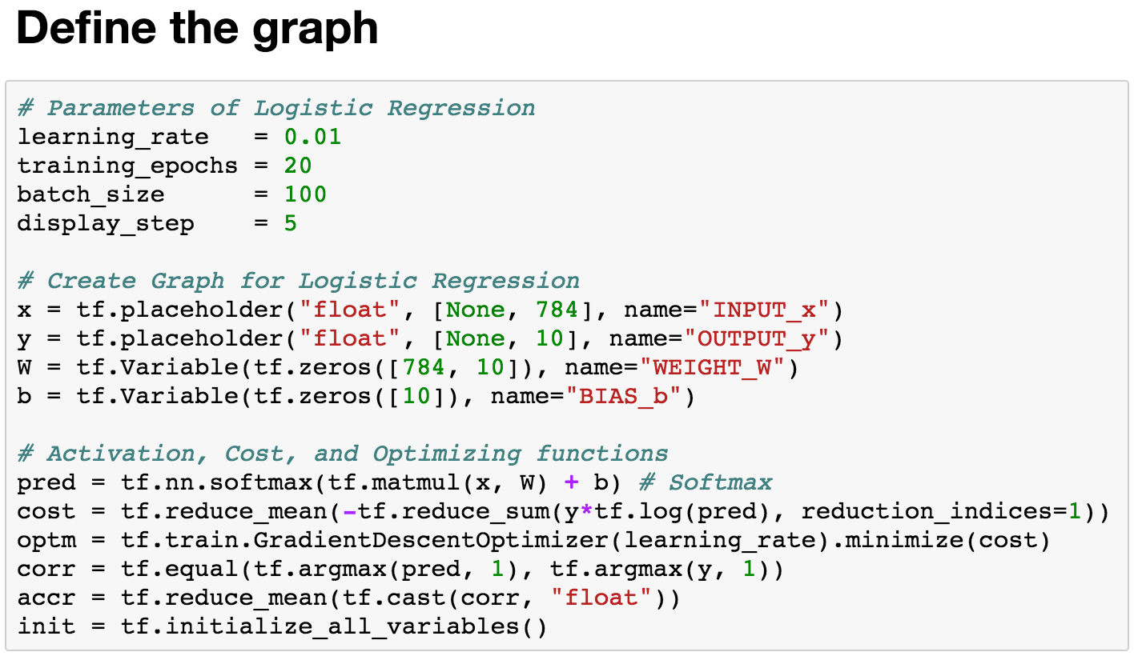

Slide 6
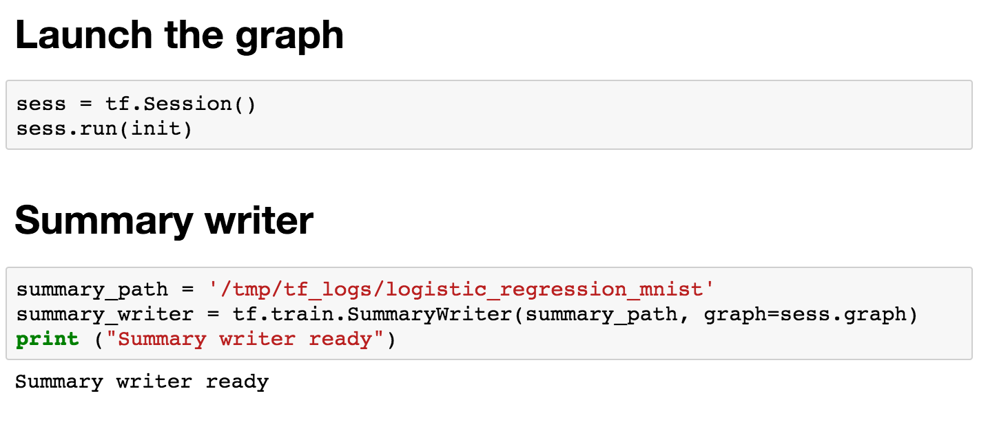

Slide 7
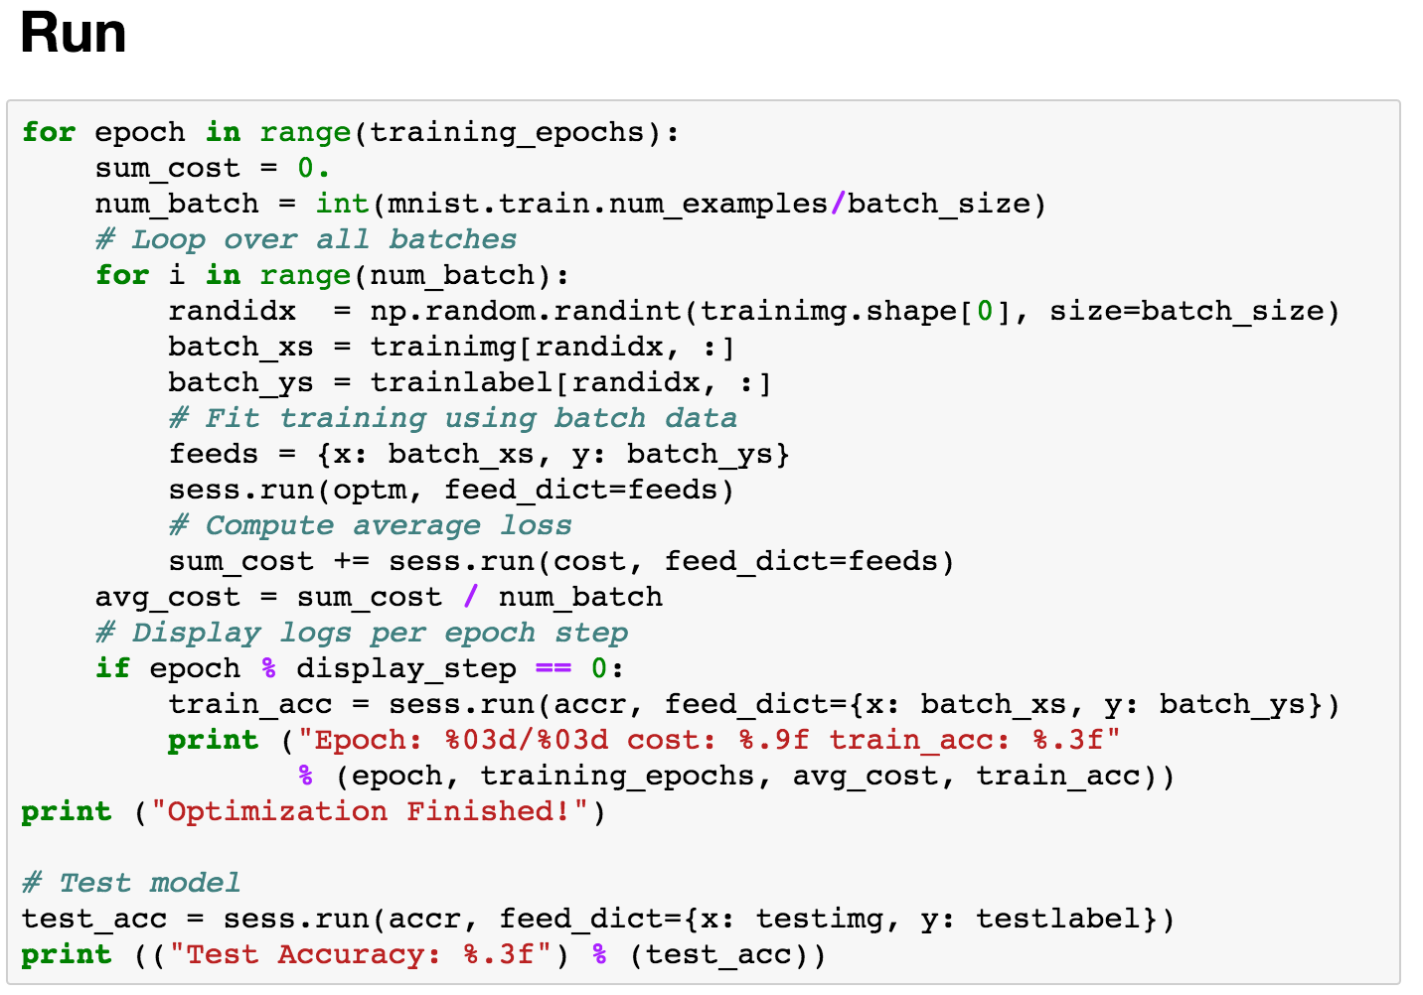

Slide 8
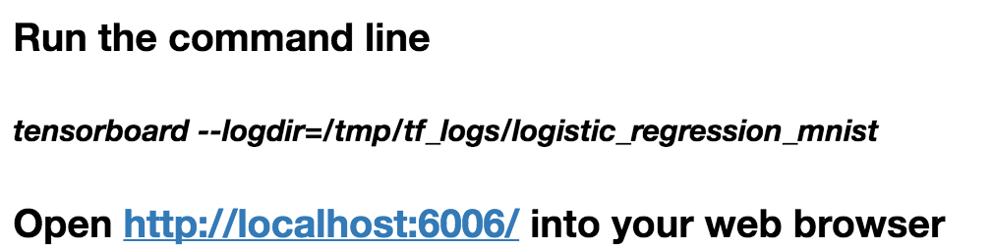

Slide 9
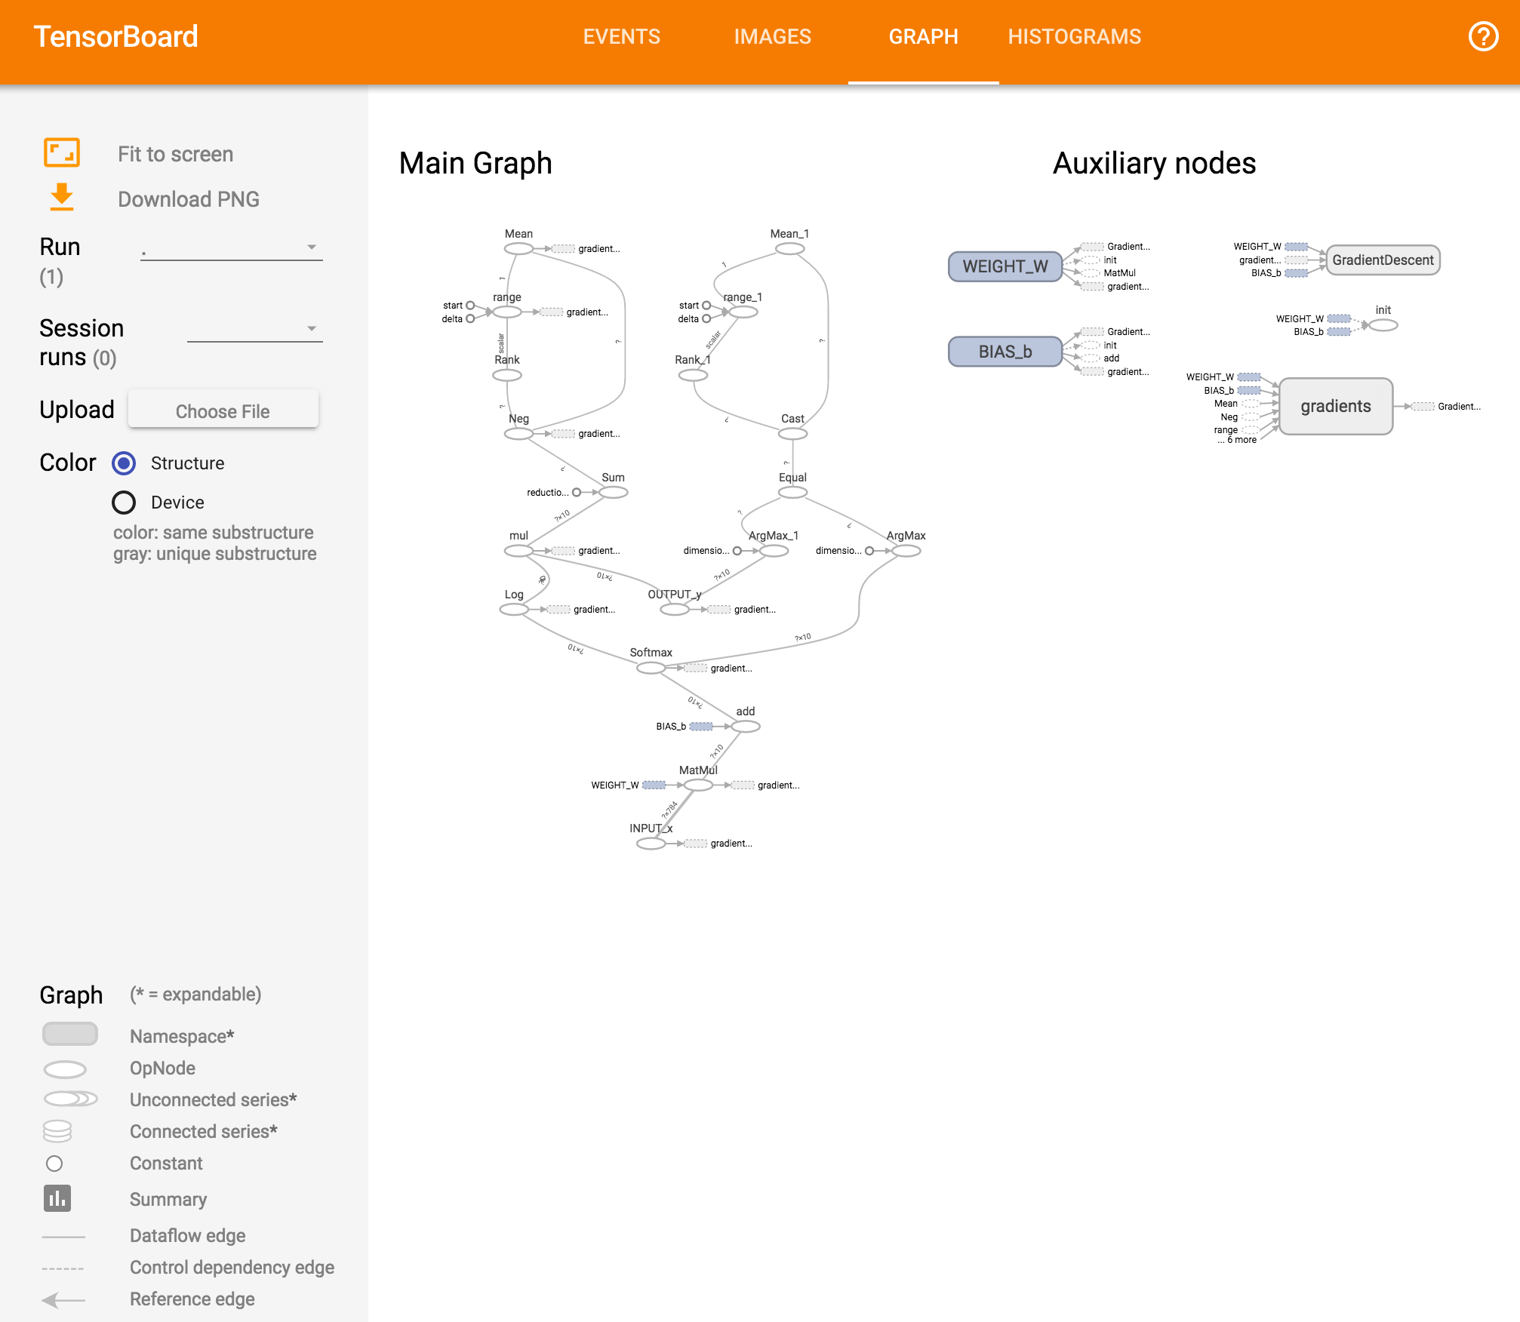

Slide 10
TensorBoard
Multi-layer perceptron

Slide 11
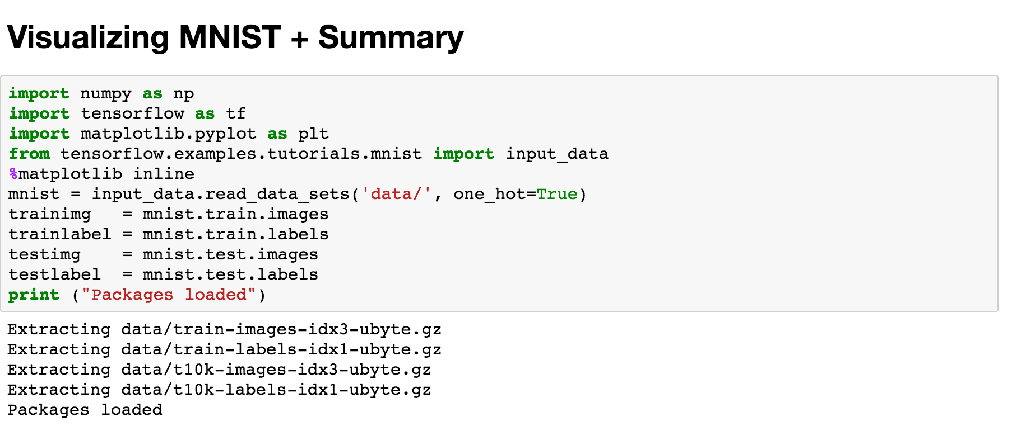

Slide 12
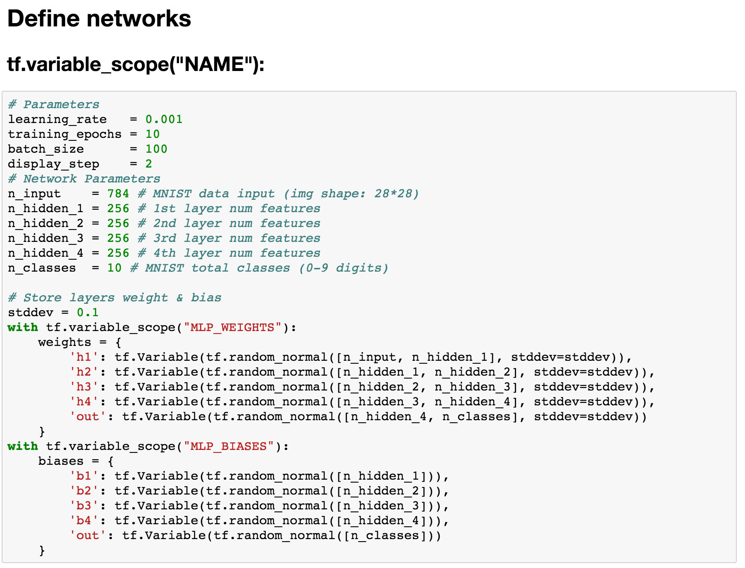

Slide 13
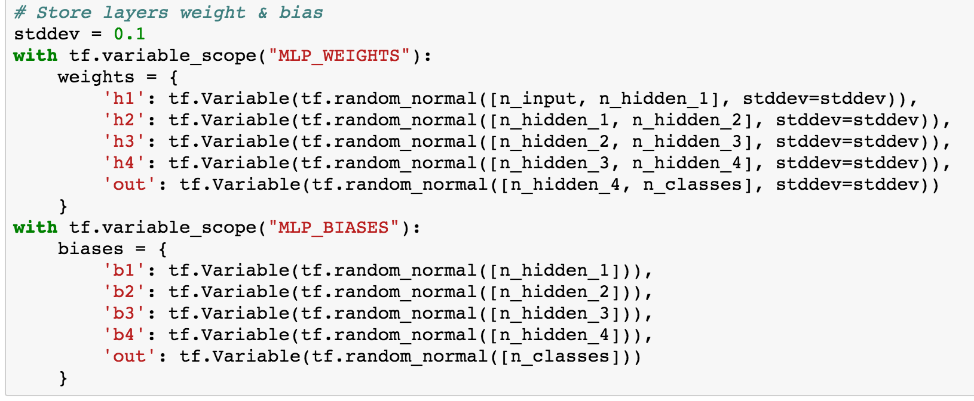

Slide 14
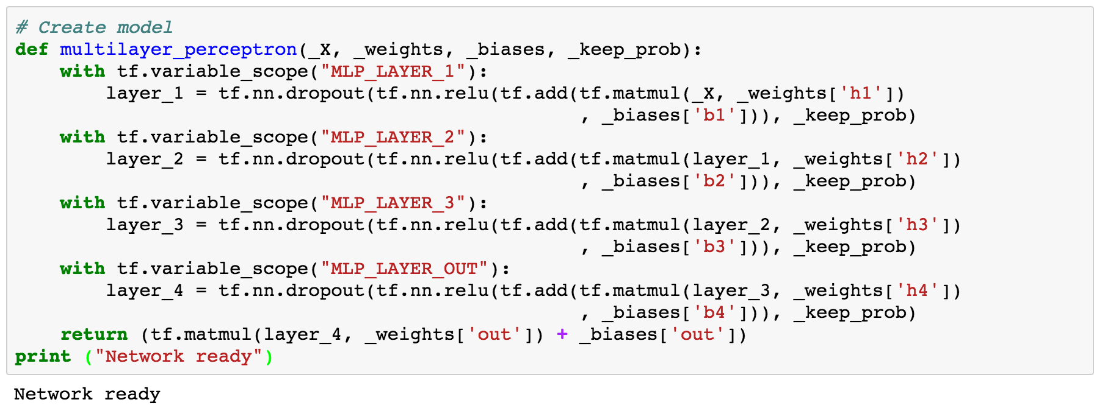

Slide 15
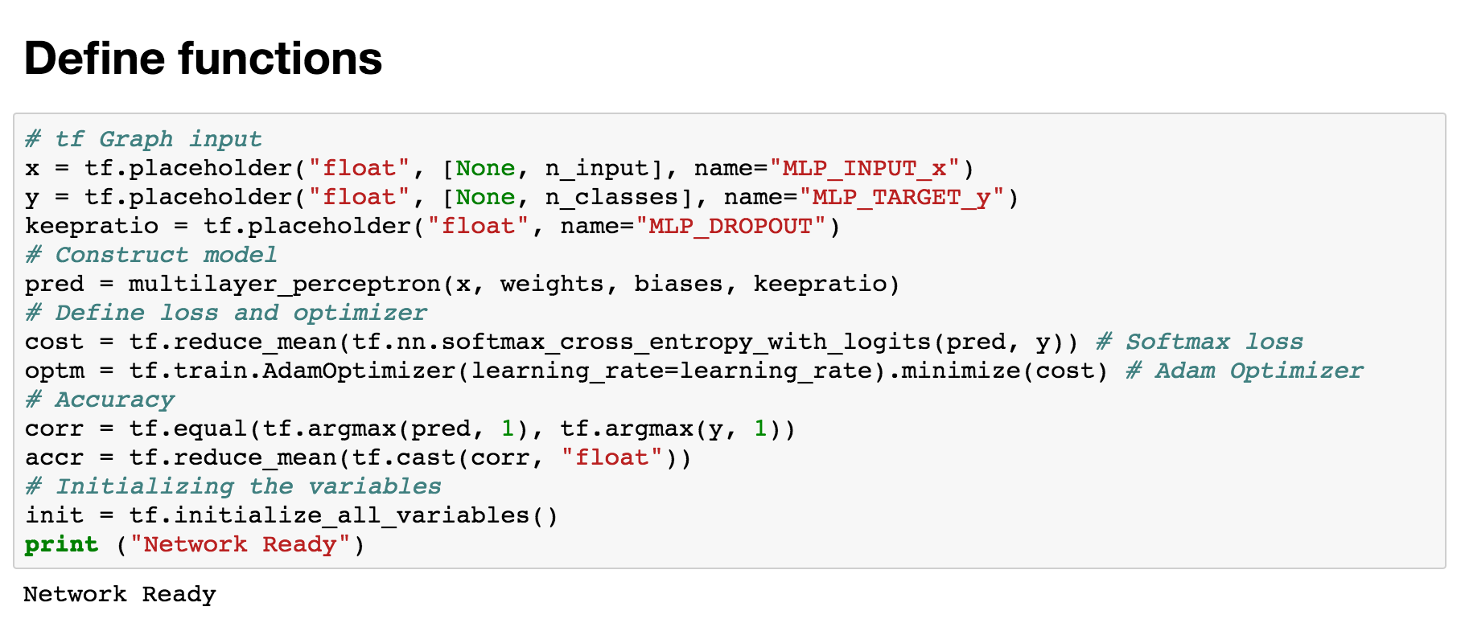

Slide 16
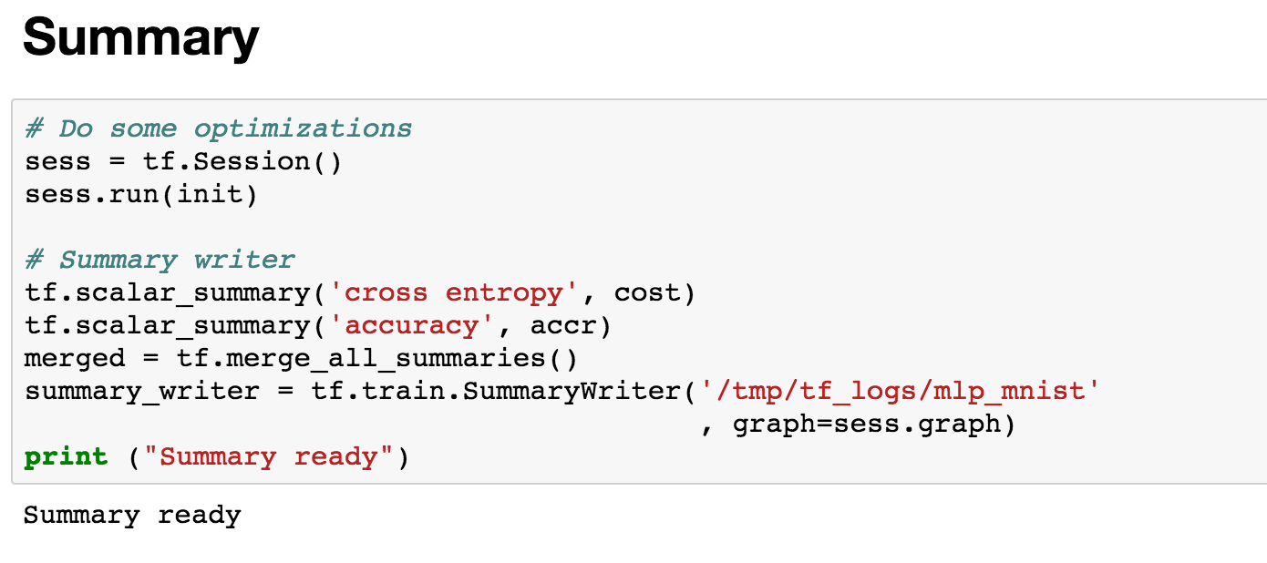

Slide 17
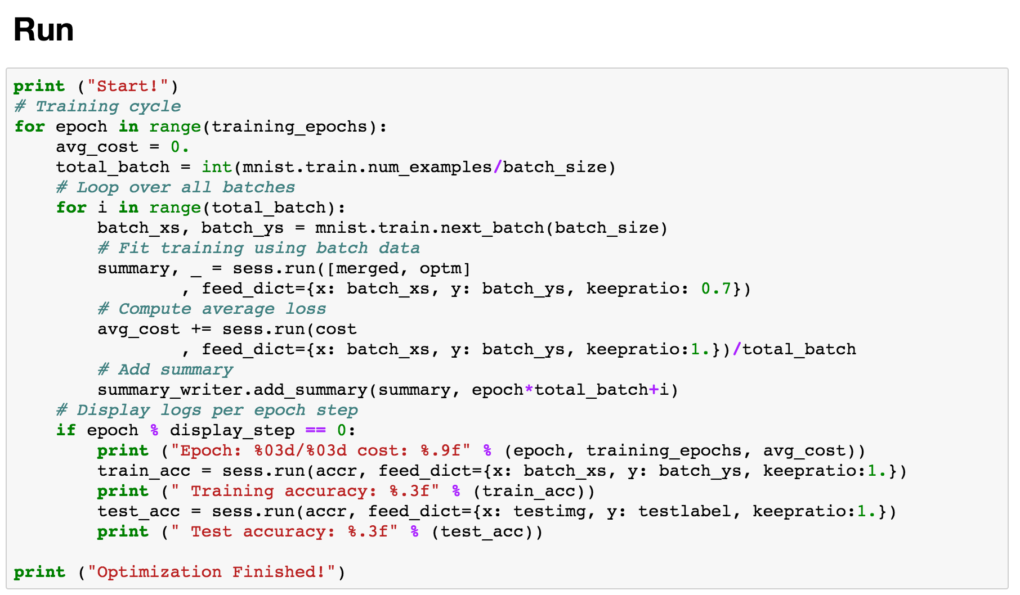

Slide 18
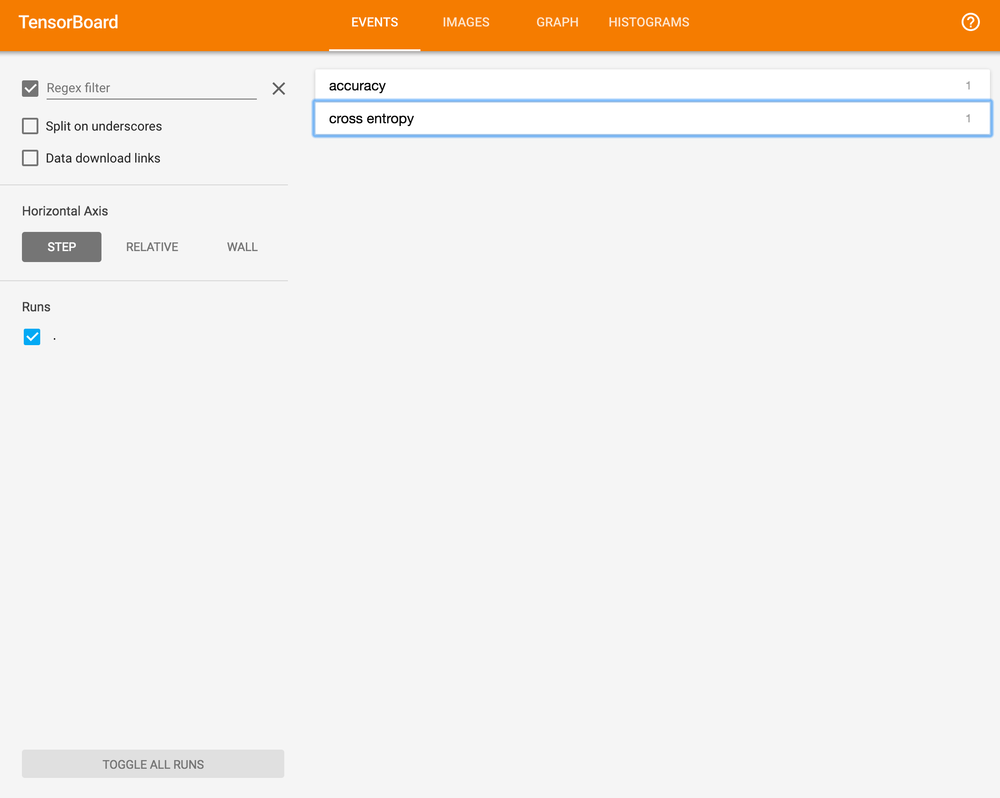

Slide 19
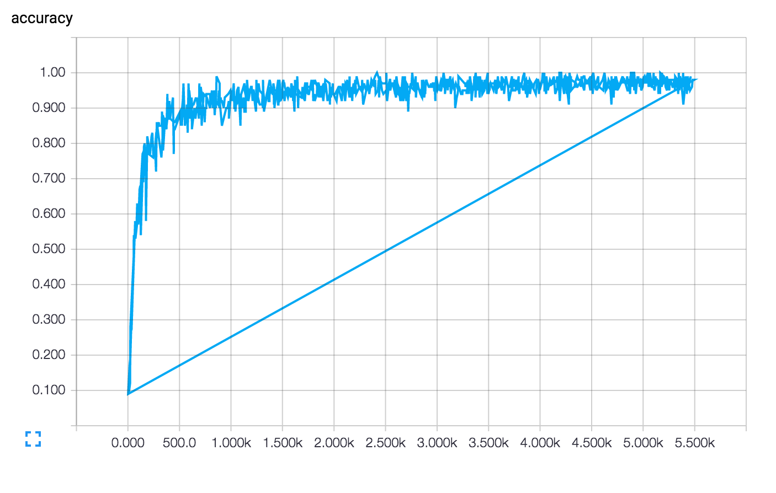

Slide 20
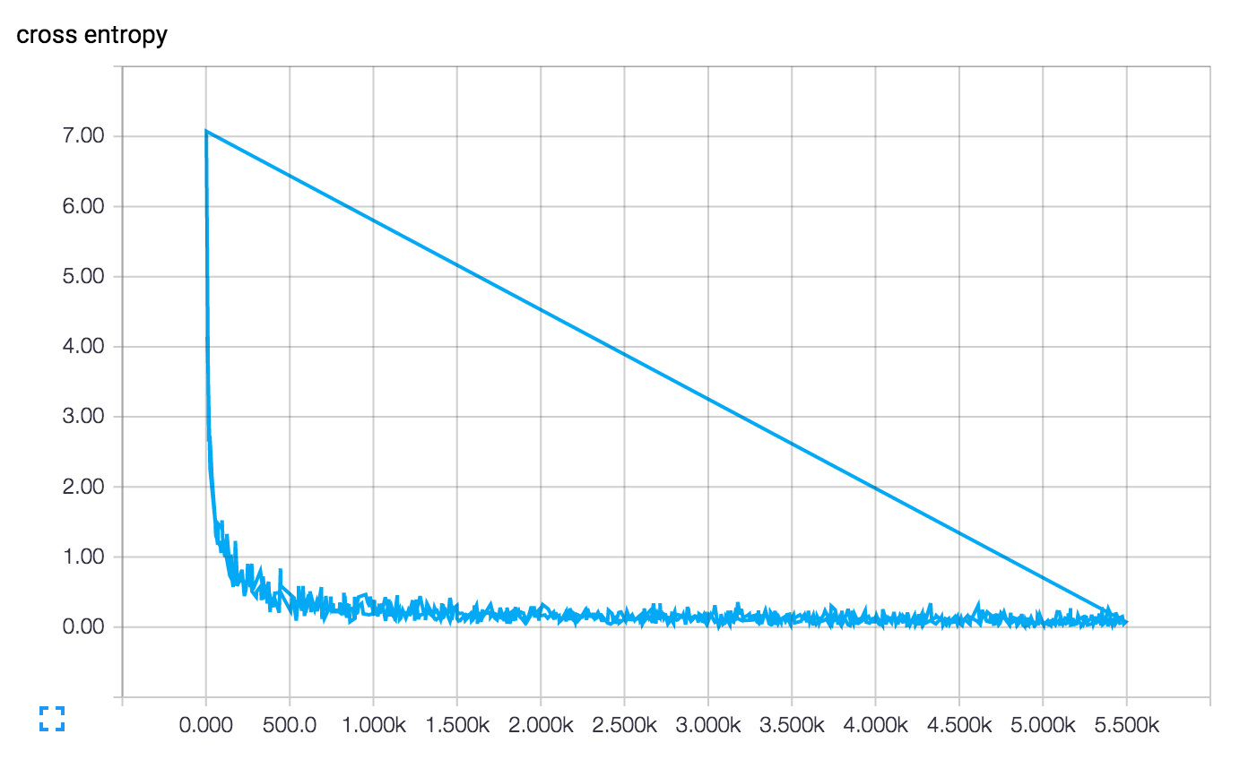

Slide 21
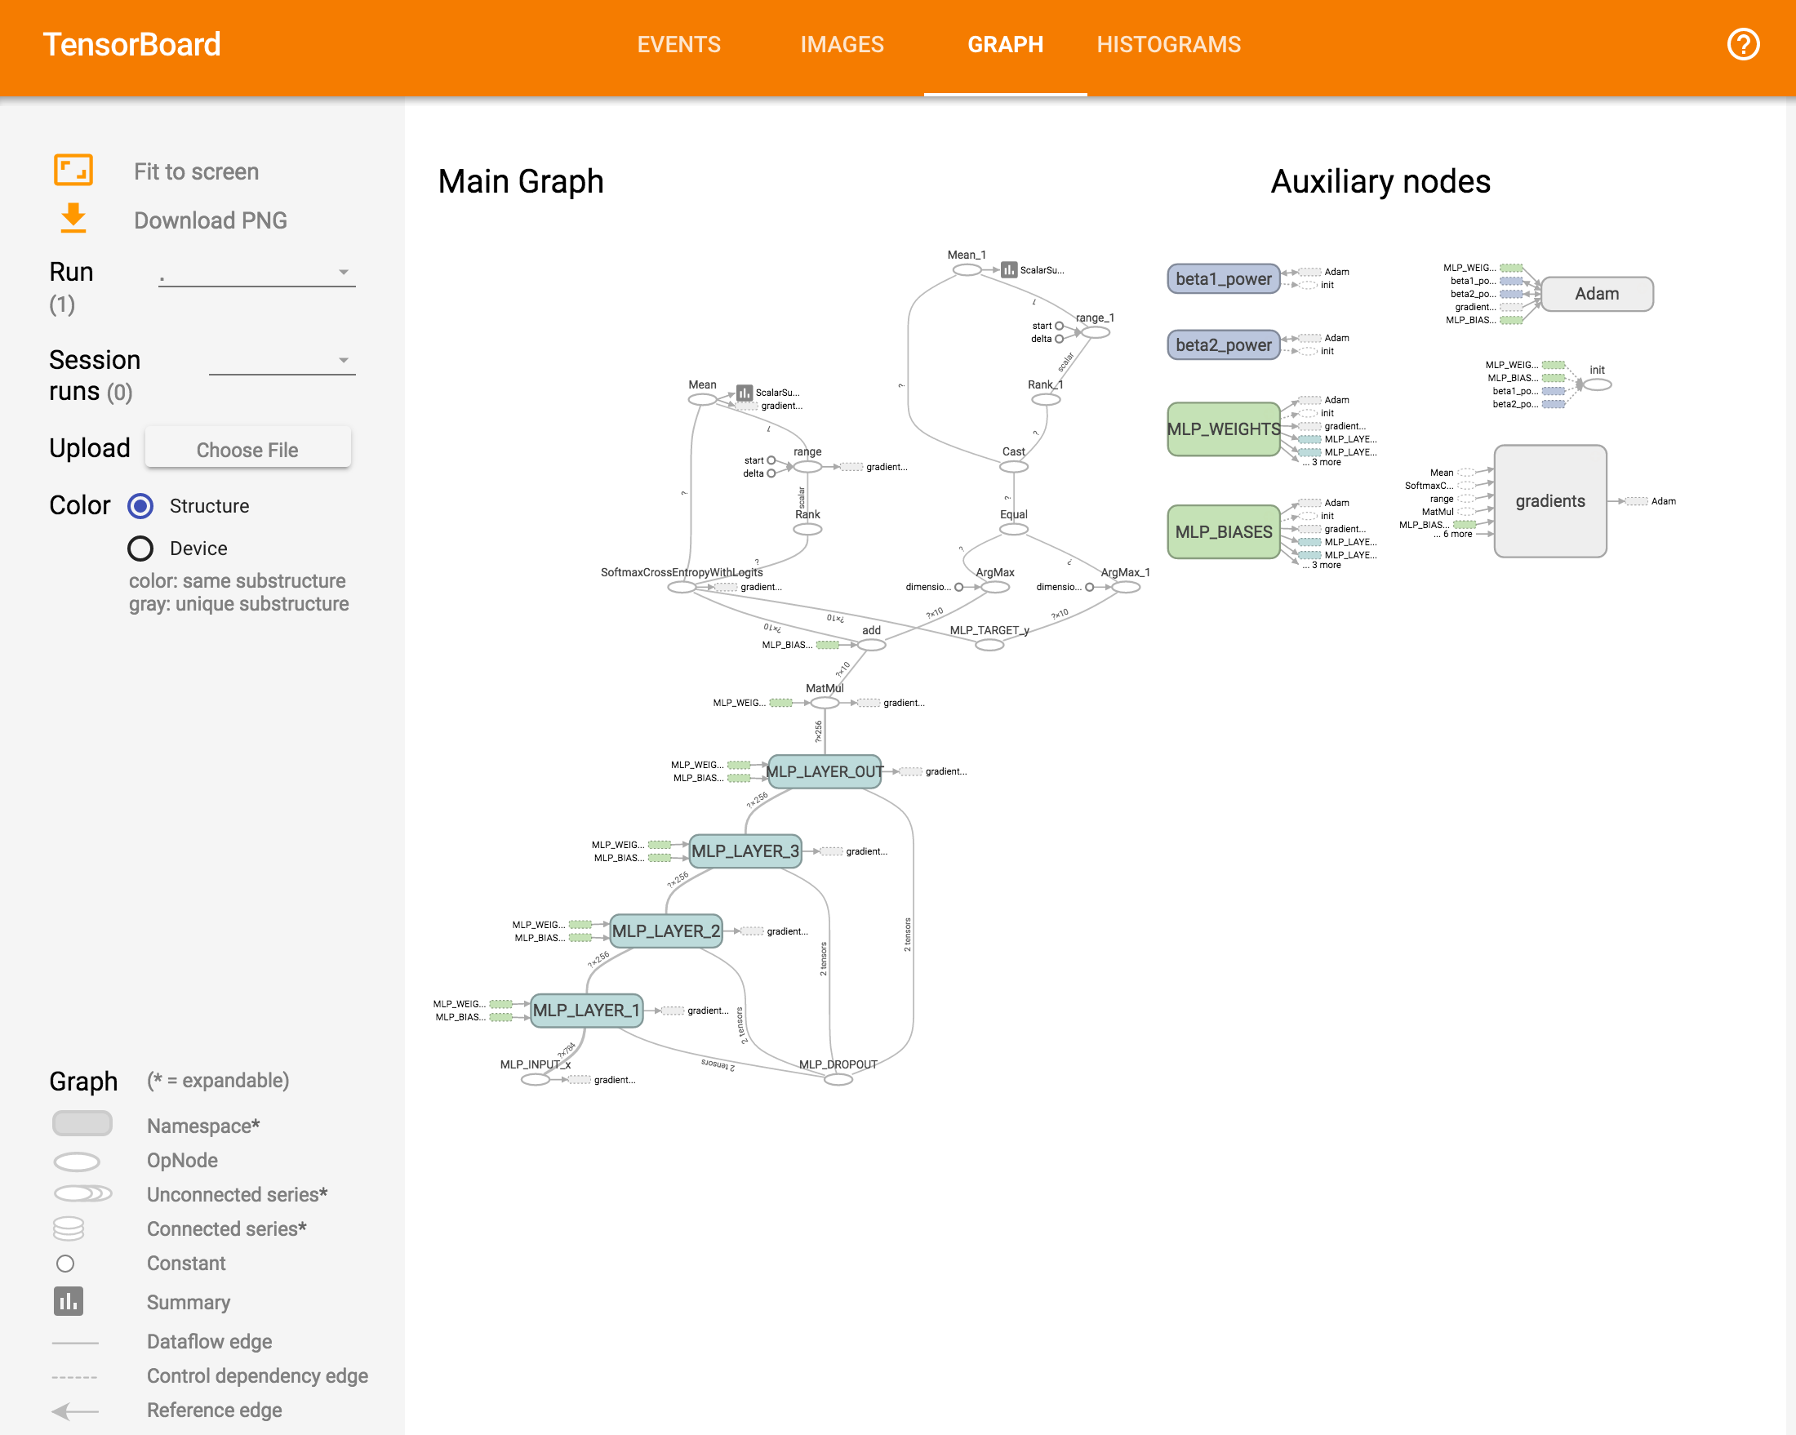

Slide 22
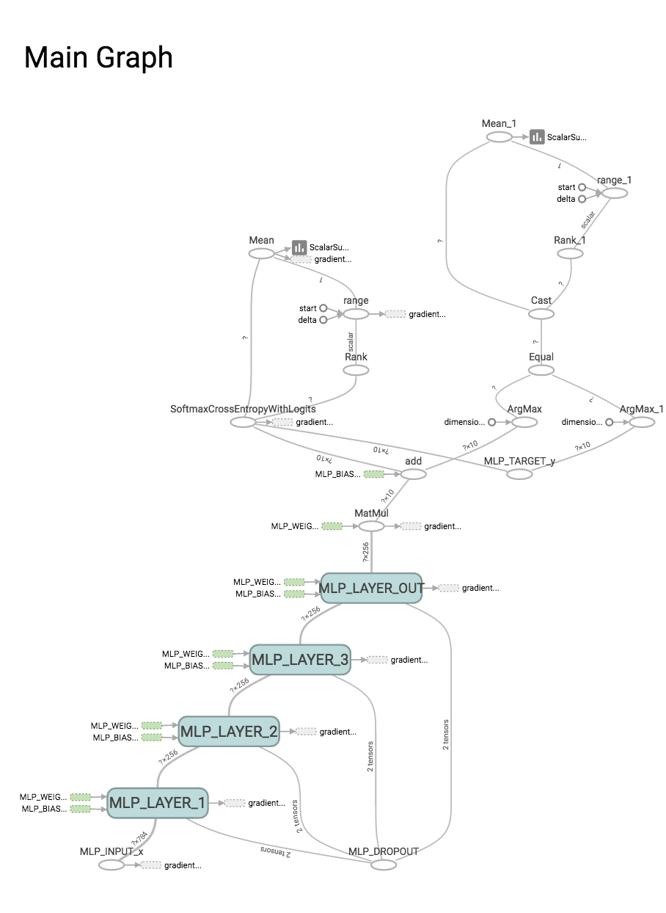

Slide 23
TensorBoard
Multi-layer perceptron

Slide 24
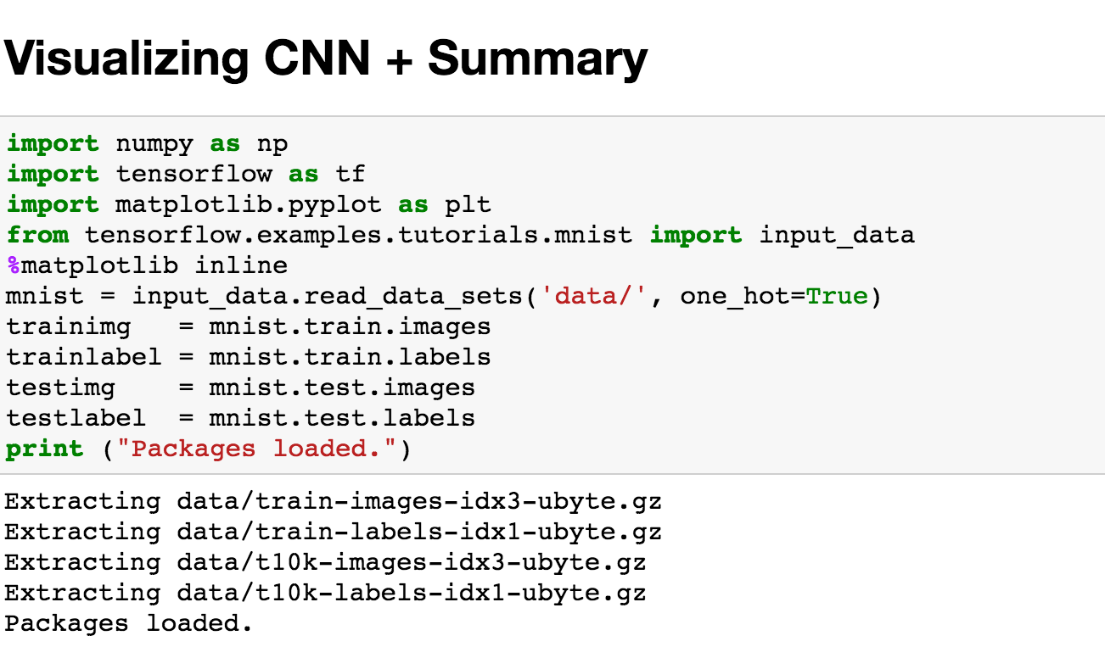

Slide 25
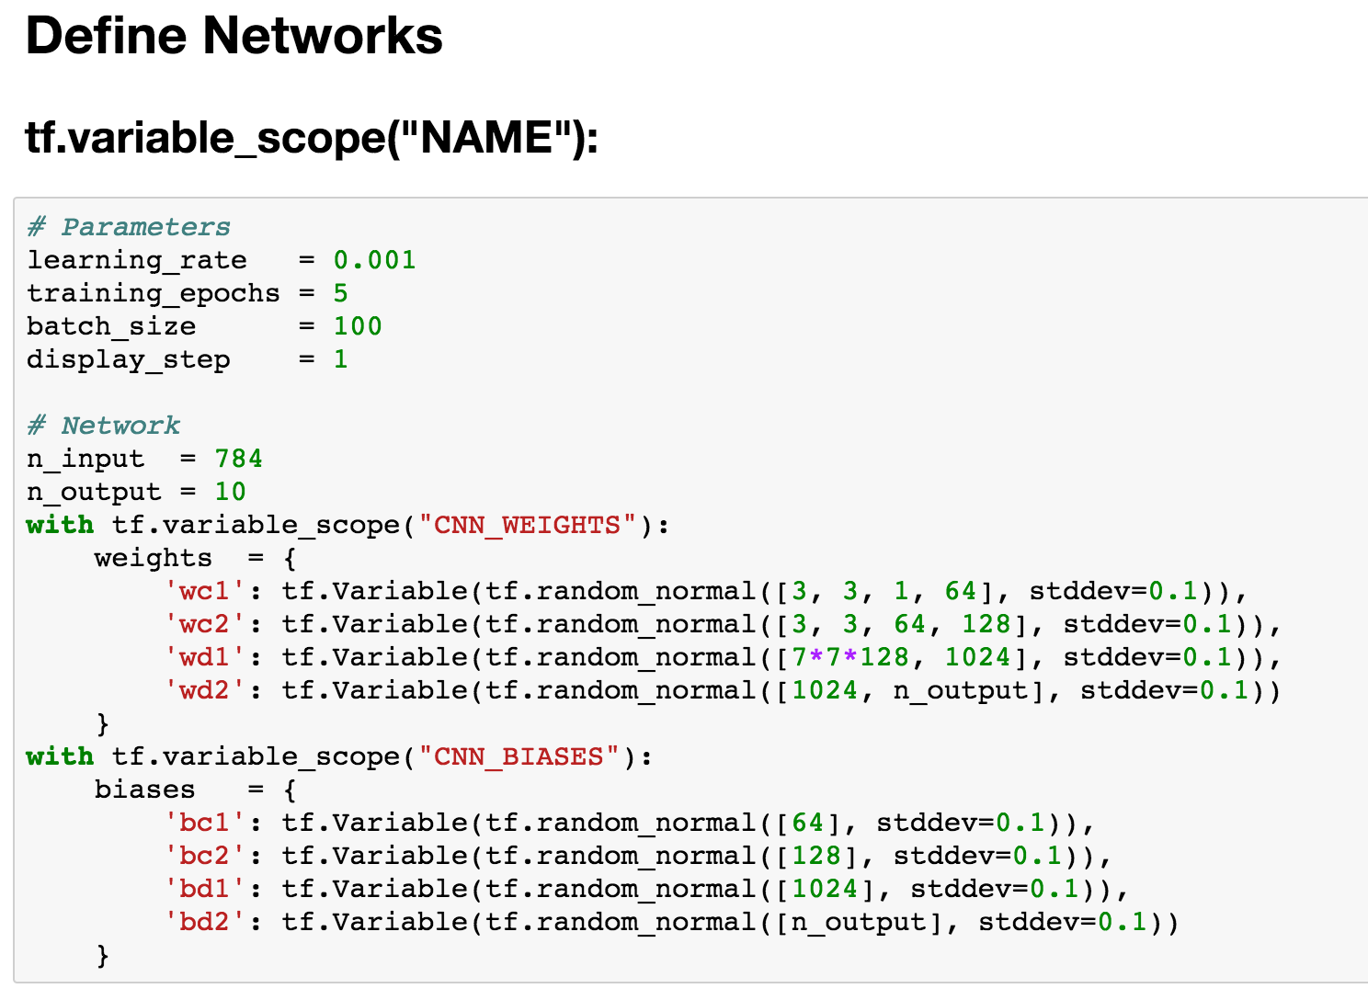

Slide 26
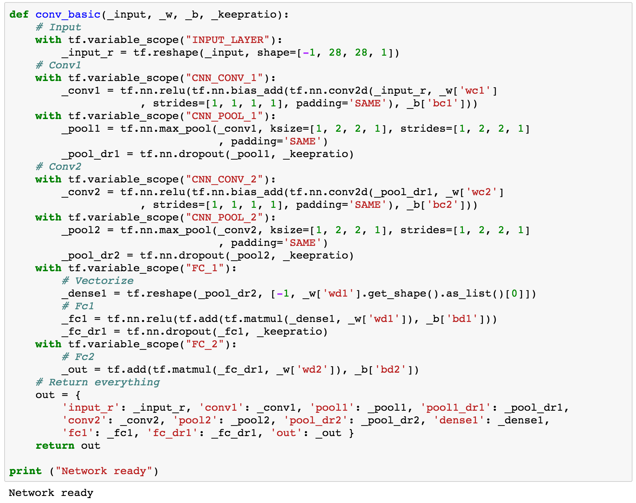

Slide 27
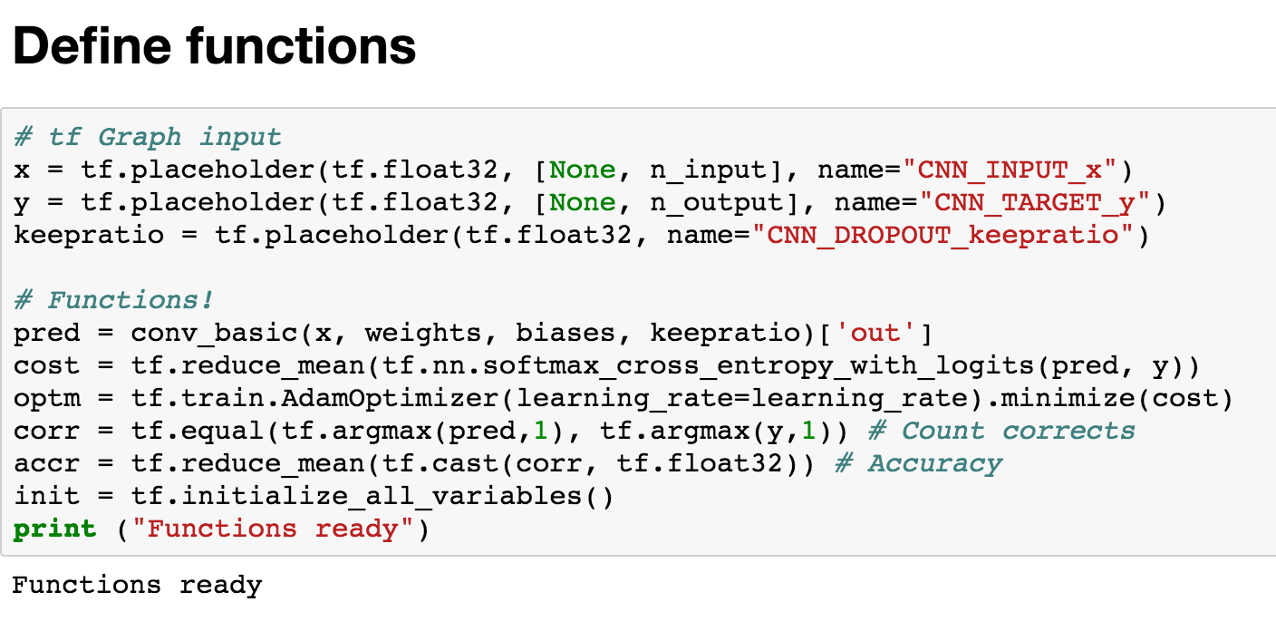

Slide 28
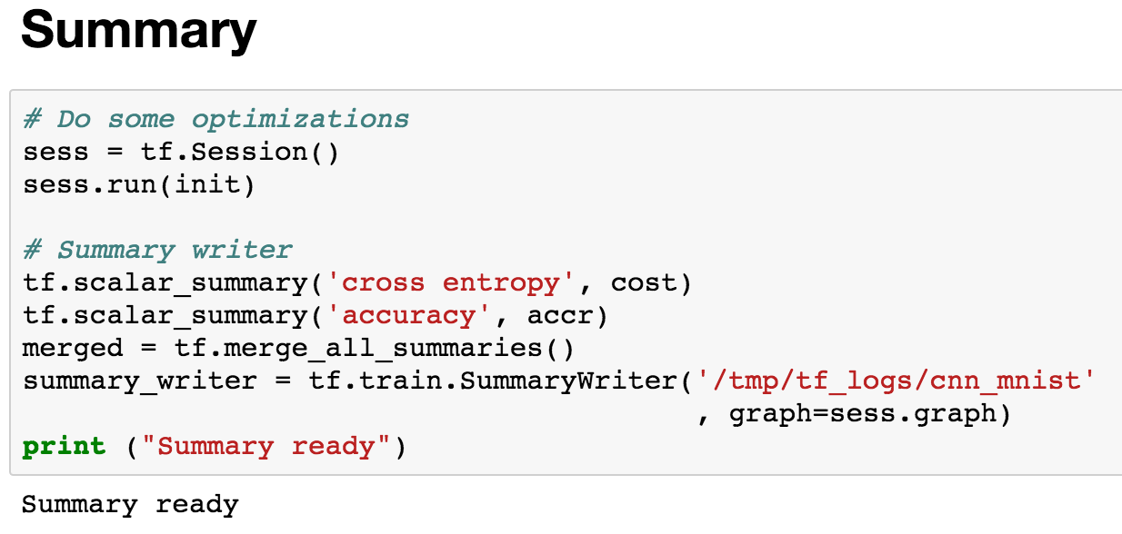

Slide 29
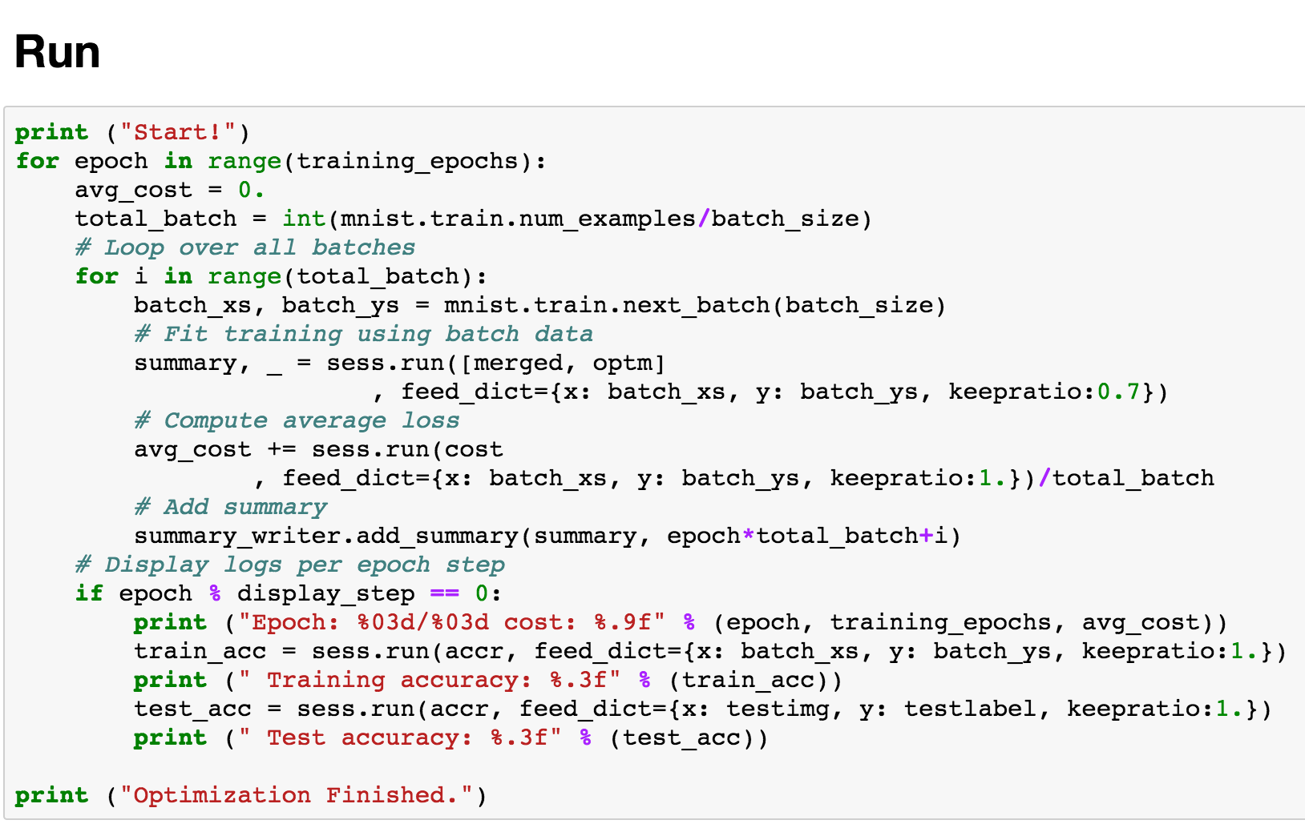
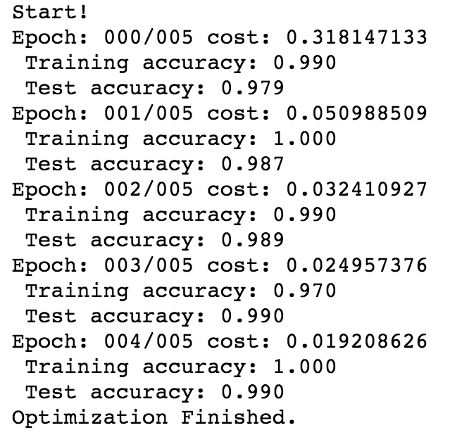

Slide 30
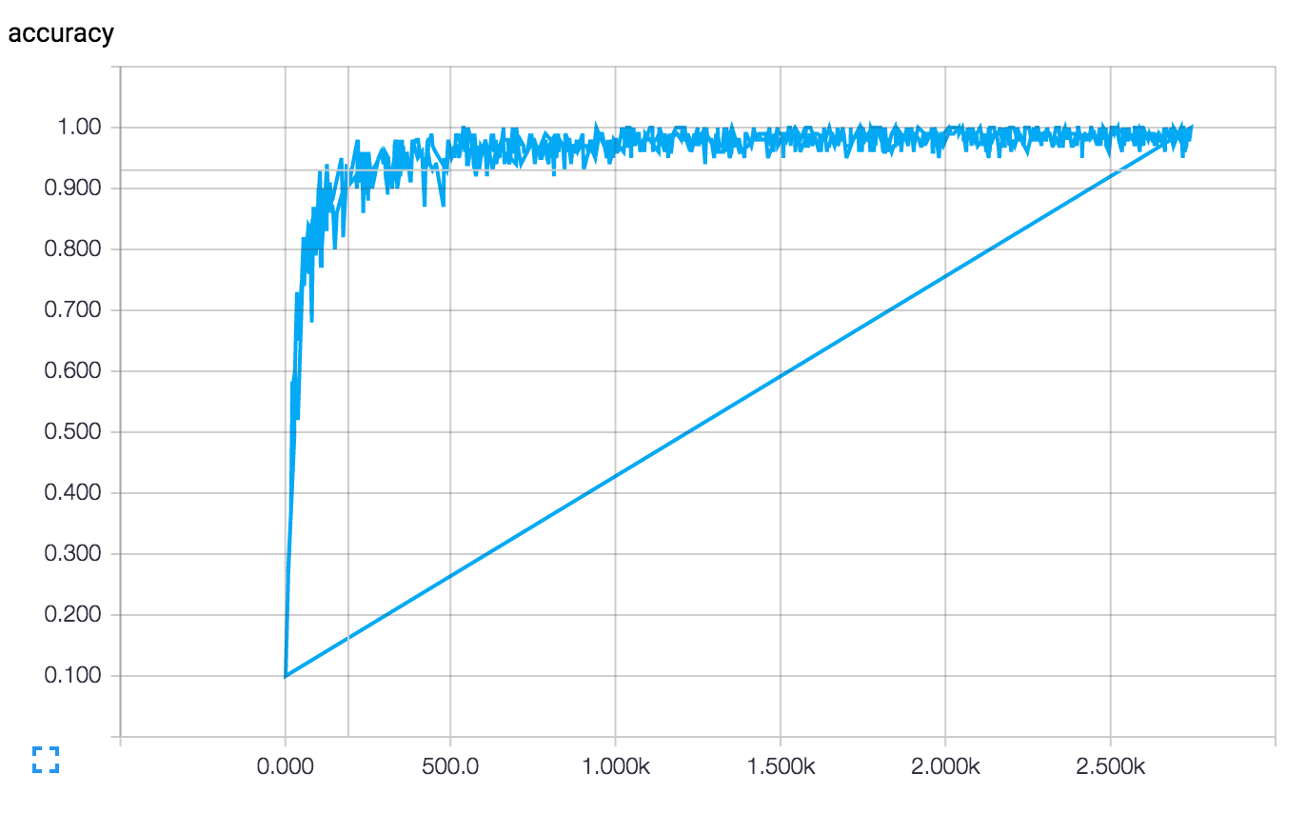

Slide 31
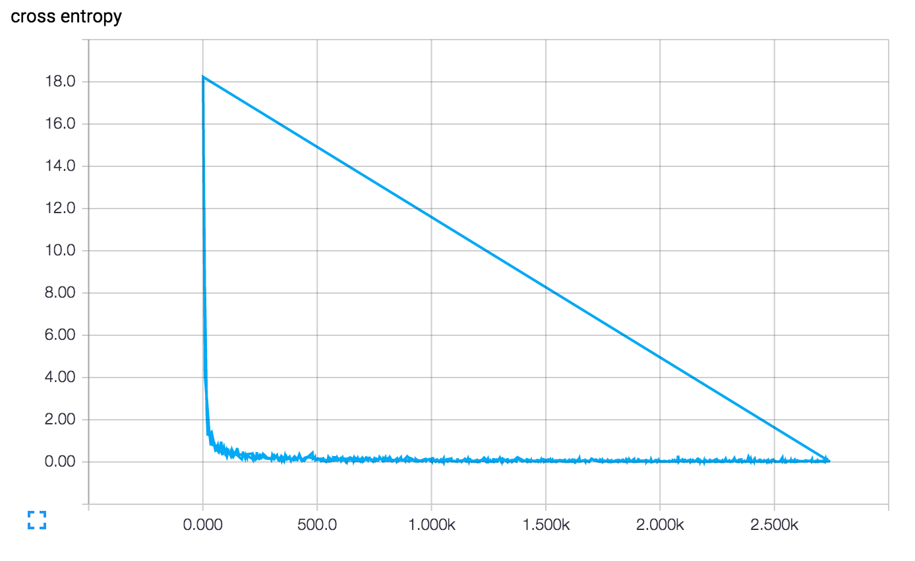

Slide 32
